Slide 1
Sequence Model Part 1

Slide 2
Reminder
Next week is presentation of final project proposals
Please upload your slides to canvas before class
Syllabus is updated to reflect the change in schedule

Slide 3
Brief Request
If you have recently interviewed for a job related to the material of this course, and if you are willing, please reach out to me. I am interested in learning about your experience

Slide 4
Up to this point
Neural networks have had fixed inputs and outputs
i.e. MNIST is 784 pixels as an input, 10 outputs
By Glosser.ca - Own work, Derivative of File:Artificial neural network.svg, CC BY-SA 3.0, https://commons.wikimedia.org/w/index.php?curid=24913461

Slide 5
Not Every Problem is “One-to-One”
http://karpathy.github.io/2015/05/21/rnn-effectiveness/

Slide 6
One to many
Image Captioning
Input – an image
Output – description of the image (sequence of words)
http://karpathy.github.io/2015/05/21/rnn-effectiveness/

Slide 7
Many to One
Sentiment Analysis
Input – Sequence of words
Output – the sentiment (positive/negative) for the sentence
Image from caption
Input – Caption for an image
Output – an image
http://karpathy.github.io/2015/05/21/rnn-effectiveness/

Slide 8
Many to Many (not paired)
Sequence translation
Input – text in one language
Output – text in another language
http://karpathy.github.io/2015/05/21/rnn-effectiveness/

Slide 9
Many to Many (paired)
Frame by frame video classification
Input - Video frames
Output – classification of each frame
Text generation
Input –
Output – text sequence
http://karpathy.github.io/2015/05/21/rnn-effectiveness/

Slide 10
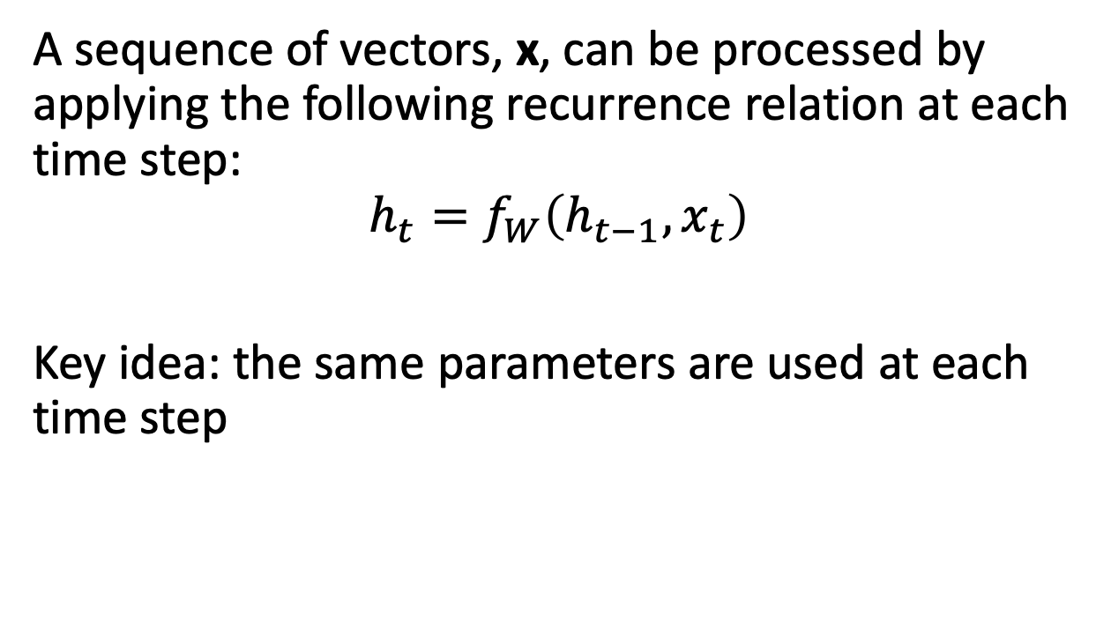
Recurrent Neural Networks
A sequence of vectors, x, can be processed by applying the following recurrence relation at each time step:
$$h_{t}=f_{W}\left(h_{t−1}, x_{t}\right)$$
Key idea: the same parameters are used at each time step

Slide 11
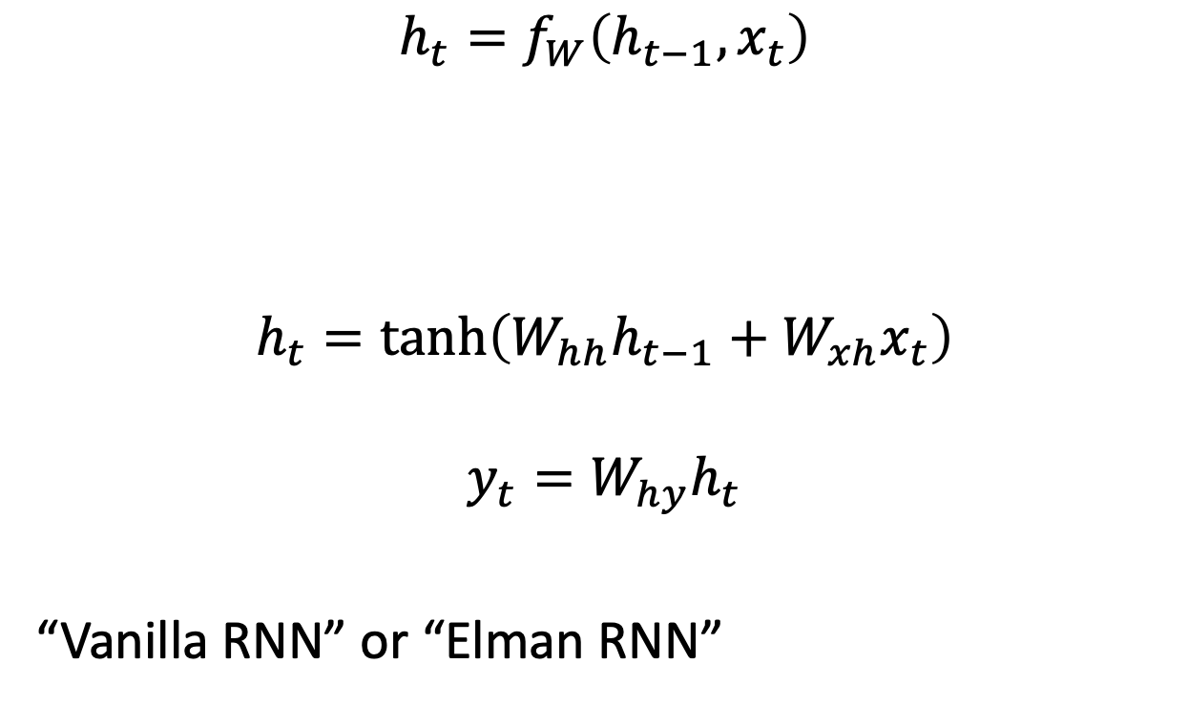
Recurrent Neural Networks
$$h_{t}=f_{W}\left(h_{t−1}, x_{t}\right)$$
$$h_{t}=\tanh\left(W_{hh}h_{t−1}+W_{xh}x_{t}\right)$$
$$y_{t}=W_{hy}h_{t}$$
“Vanilla RNN” or “Elman RNN”

Slide 12
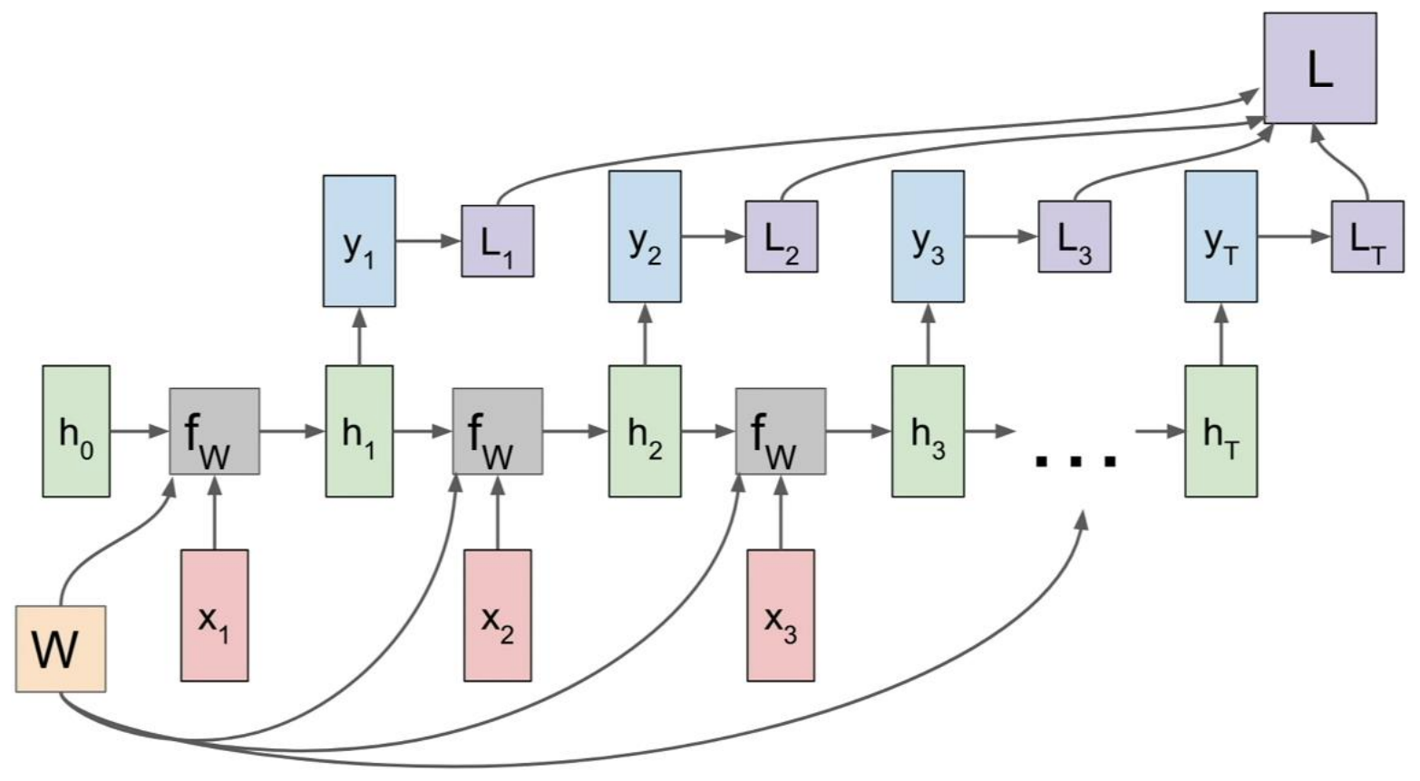
Many to Many RNN Computation Graph

Slide 13
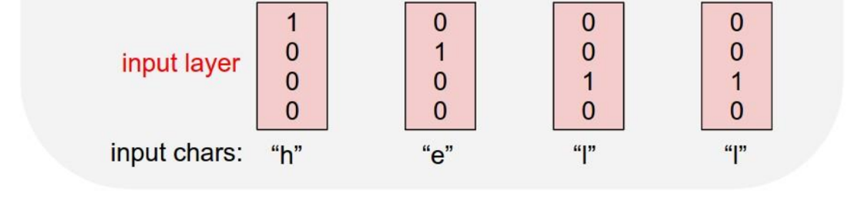
Example: Character-level Language Model
Vocabulary: [h,e,l,o]
Training Sequence: “hello”

Slide 14
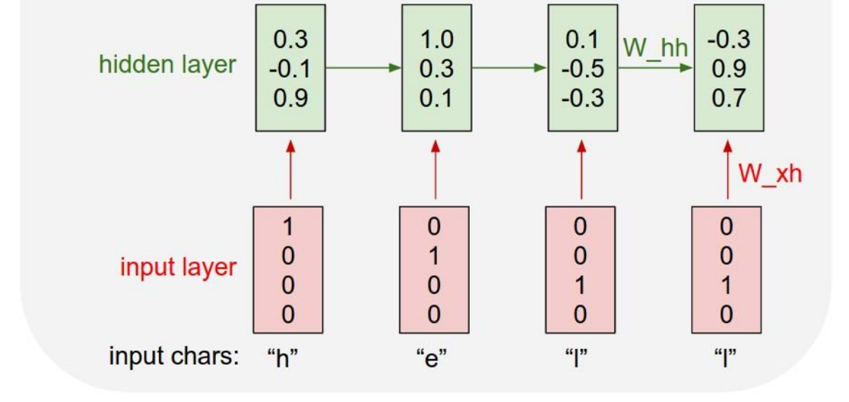
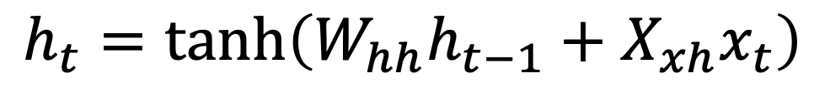
Example: Character-level Language Model
Vocabulary: [h,e,l,o]
Training Sequence: “hello”
$$h_{t}=\tanh\left(W_{hh}h_{t−1}+X_{xh}x_{t}\right)$$

Slide 15
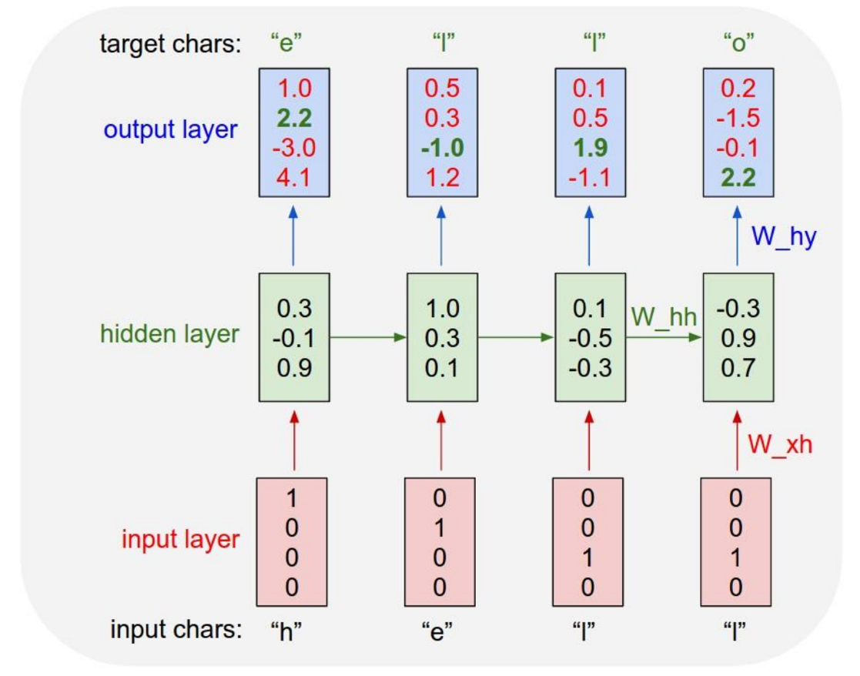
Example: Character-level Language Model
Vocabulary: [h,e,l,o]
Training Sequence: “hello”

Slide 16
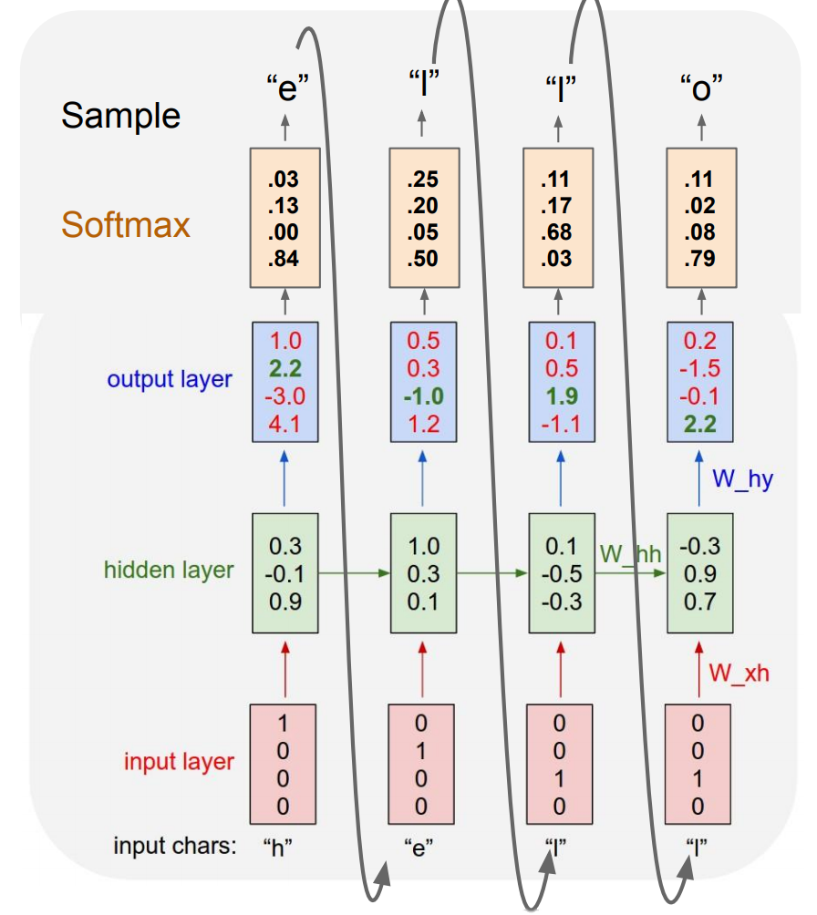
Example: Character-level Language Model
Vocabulary: [h,e,l,o]
Training Sequence: “hello”
At evaluation/test time sample characters one at a time and feed into the model

Slide 17
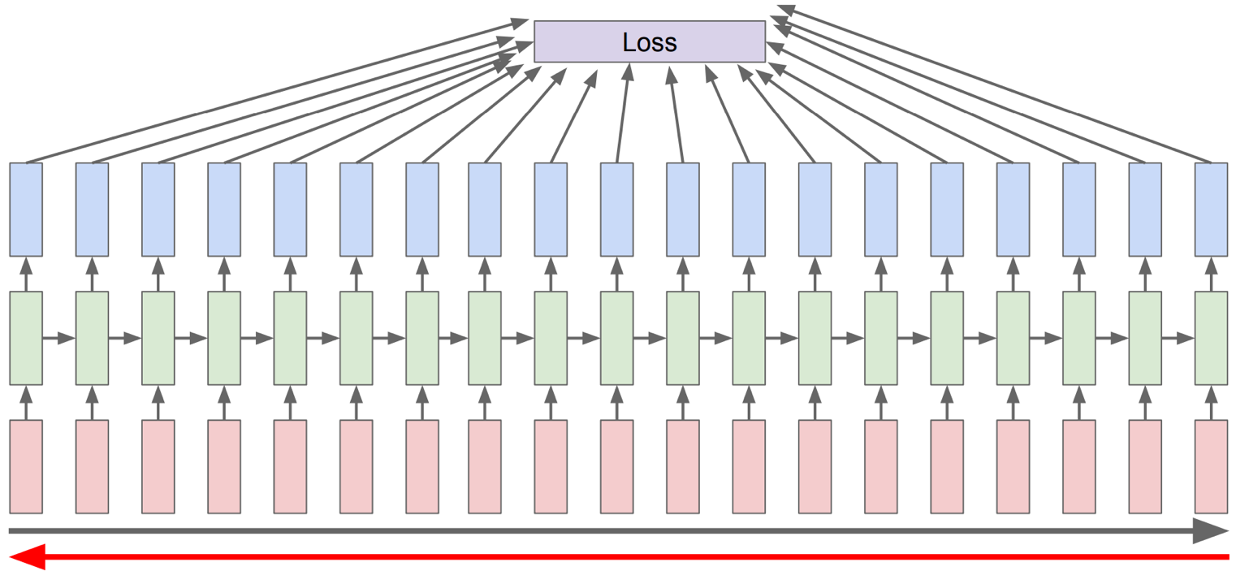
Training Recurrent Networks: Backpropogation through Time
Run a complete forward pass to compute loss, then backward through the entire sequence

Slide 18
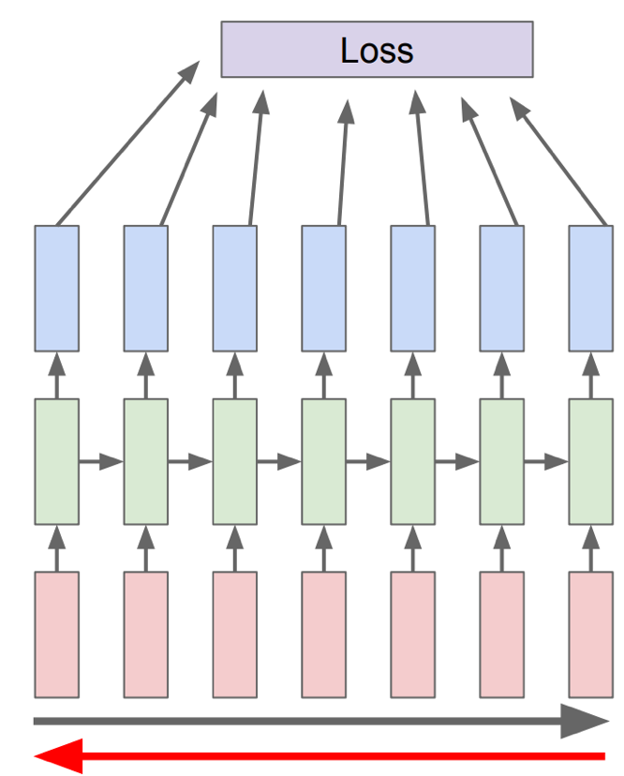
Training Recurrent Networks: Truncated Backpropogation through Time
Run a forward pass on only a portion of the training data and perform backpropagation on that sample

Slide 19
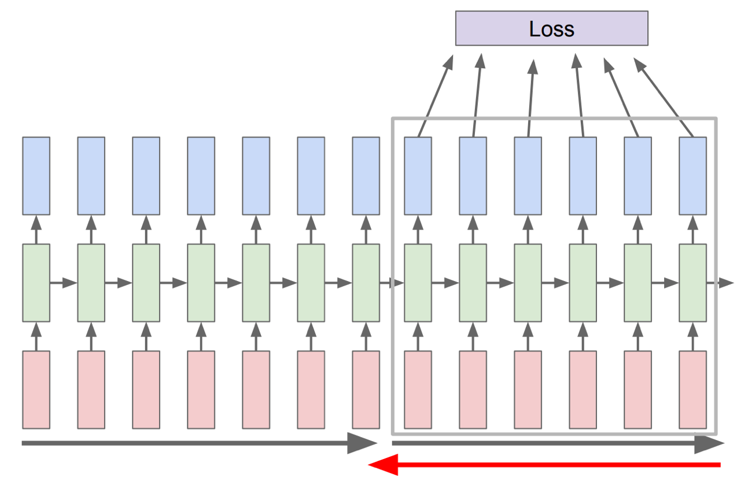
Training Recurrent Networks: Truncated Backpropogation through Time
Run the forward pass on the whole dataset, carrying the hidden state throughout. Only perform backpropagation on a portion of the hidden states

Slide 20
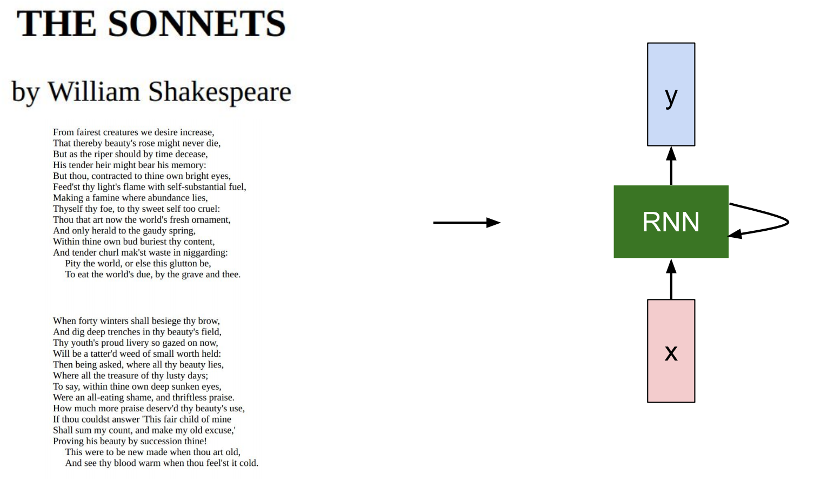

Slide 21
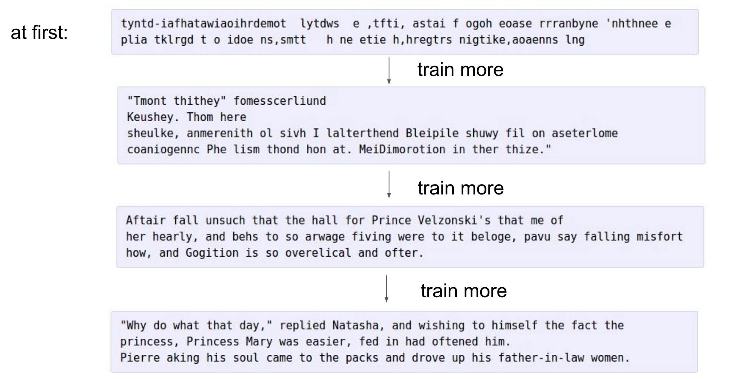

Slide 22
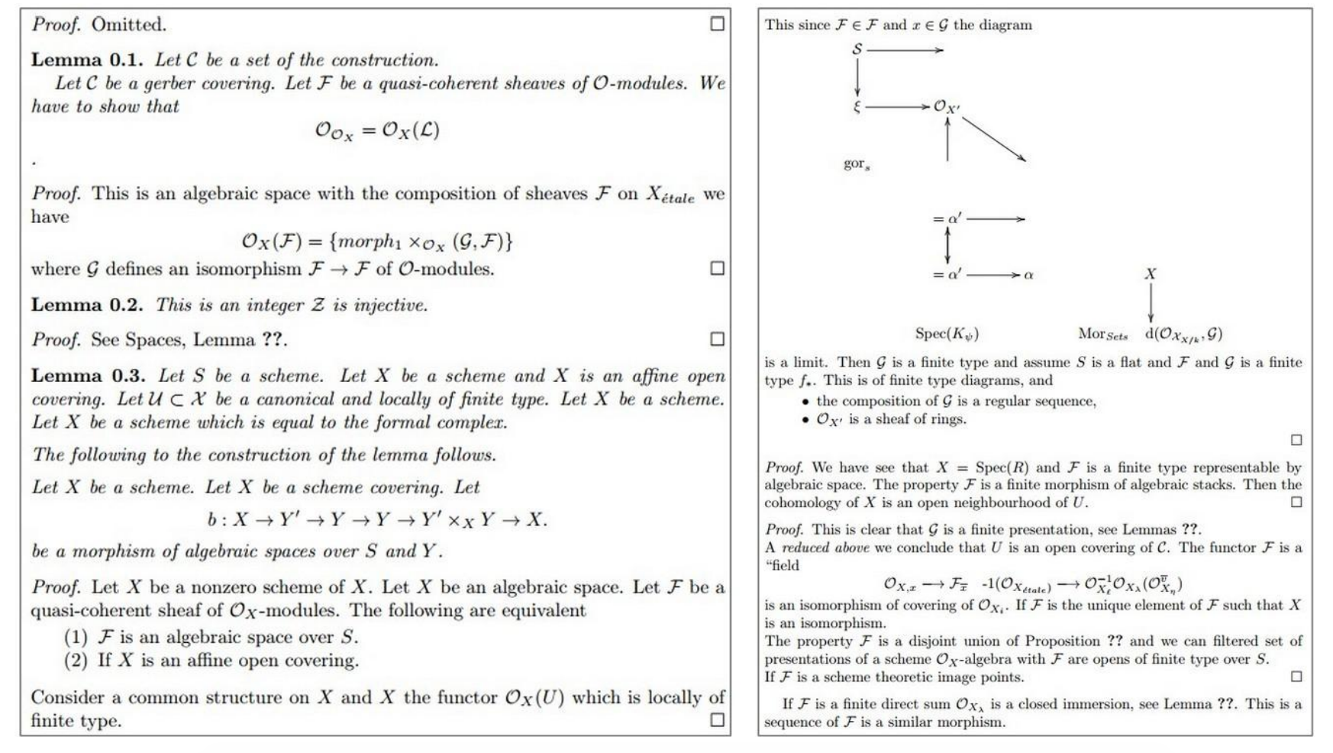

Slide 23
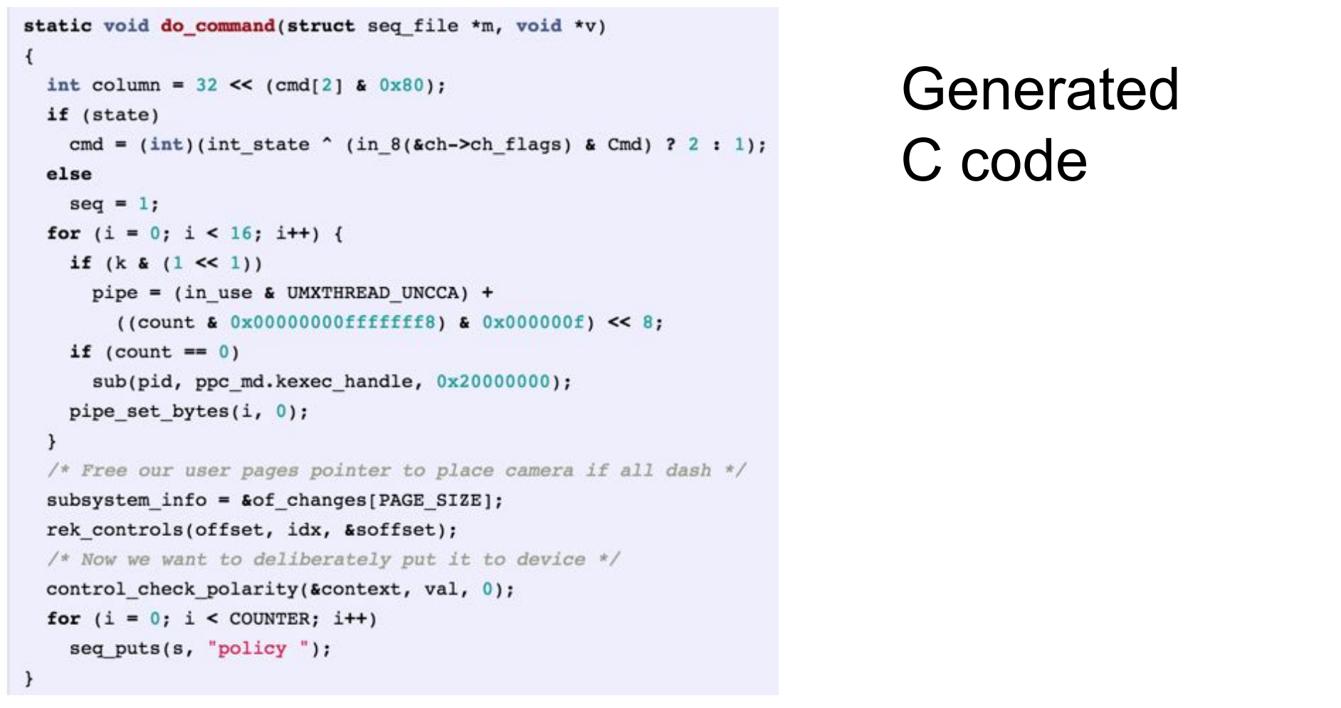

Slide 24
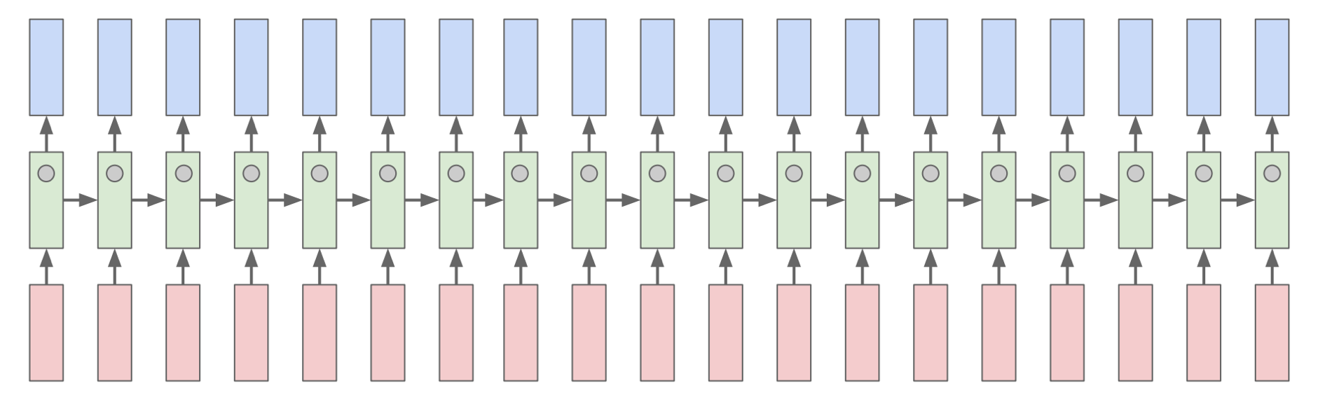
Searching for Interpretability
Karpathy, Johnson, and Fei-Fei: Visualizing and Understanding Recurrent Networks, ICLR Workshop 2016

Slide 25
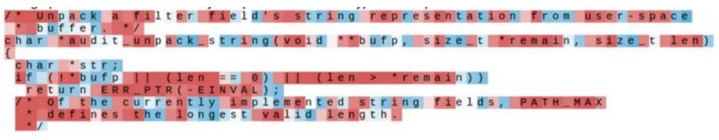
Searching for Interpretability
Karpathy, Johnson, and Fei-Fei: Visualizing and Understanding Recurrent Networks, ICLR Workshop 2016

Slide 26
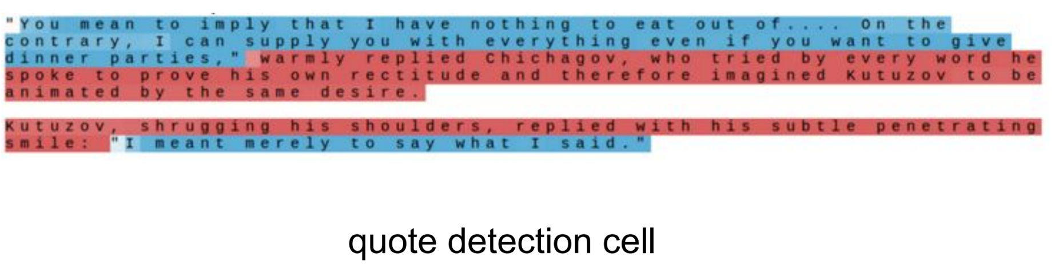
Searching for Interpretability
Karpathy, Johnson, and Fei-Fei: Visualizing and Understanding Recurrent Networks, ICLR Workshop 2016

Slide 27
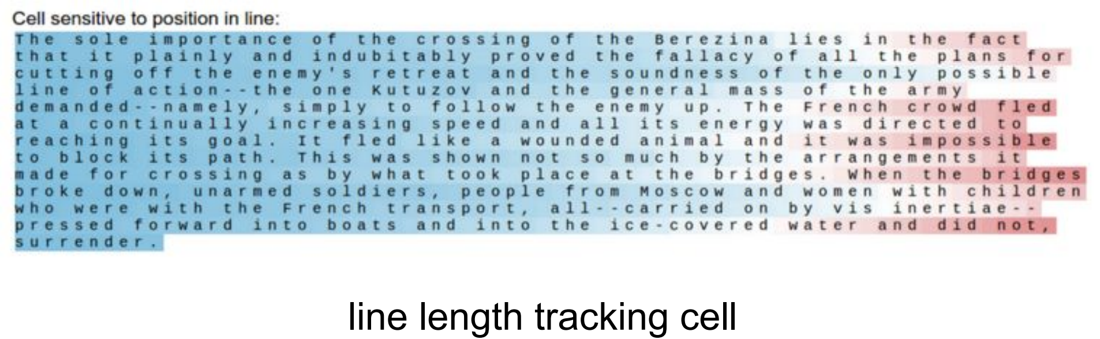
Searching for Interpretability
Karpathy, Johnson, and Fei-Fei: Visualizing and Understanding Recurrent Networks, ICLR Workshop 2016

Slide 28
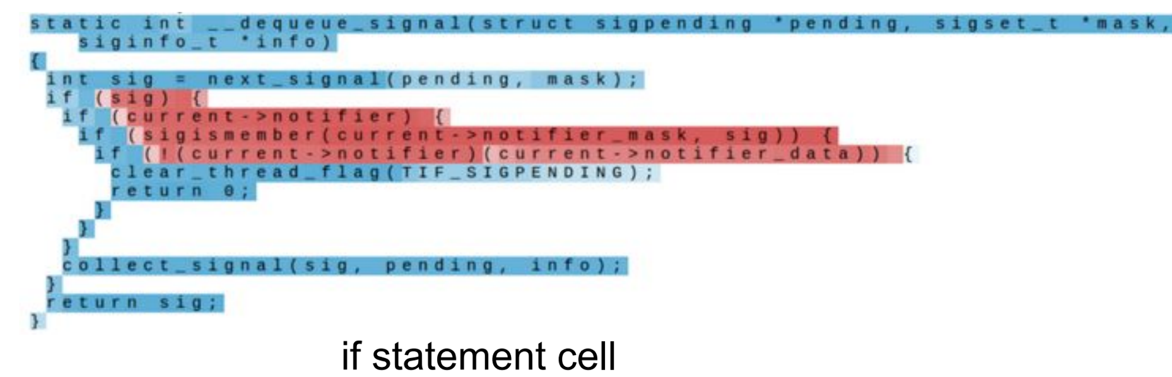
Searching for Interpretability
Karpathy, Johnson, and Fei-Fei: Visualizing and Understanding Recurrent Networks, ICLR Workshop 2016

Slide 29
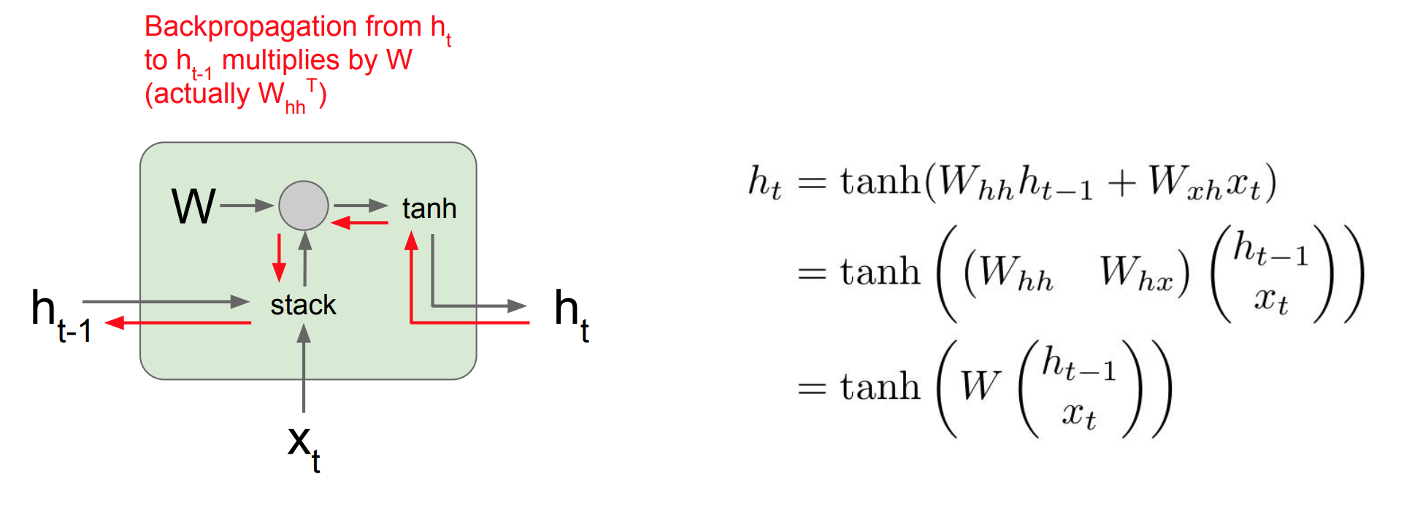
Gradient Flow in Training Recurrent Networks

Slide 30
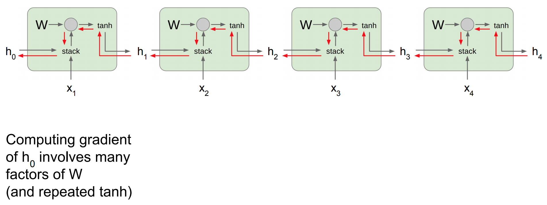
Gradient Flow in Training Recurrent Networks

Slide 31
Gradient Flow in Training Recurrent Networks
Largest singular value > 1: Exploding gradients
Largest singular value < 1: Vanishing gradients

Slide 32
Gradient Flow in Training Recurrent Networks
Gradient Clipping: Scale the gradient if its norm is too big
Largest singular value > 1: Exploding gradients
Largest singular value < 1: Vanishing gradients
Change RNN Architecture

Slide 33
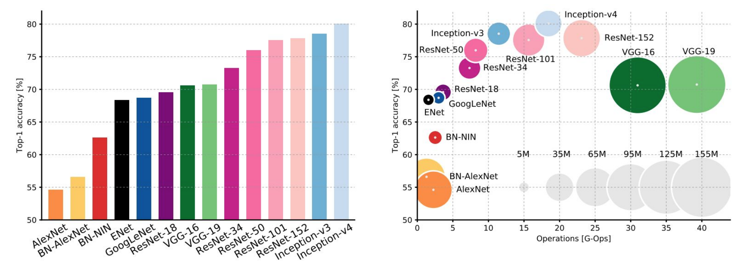
Changing Architectures Review

Slide 34
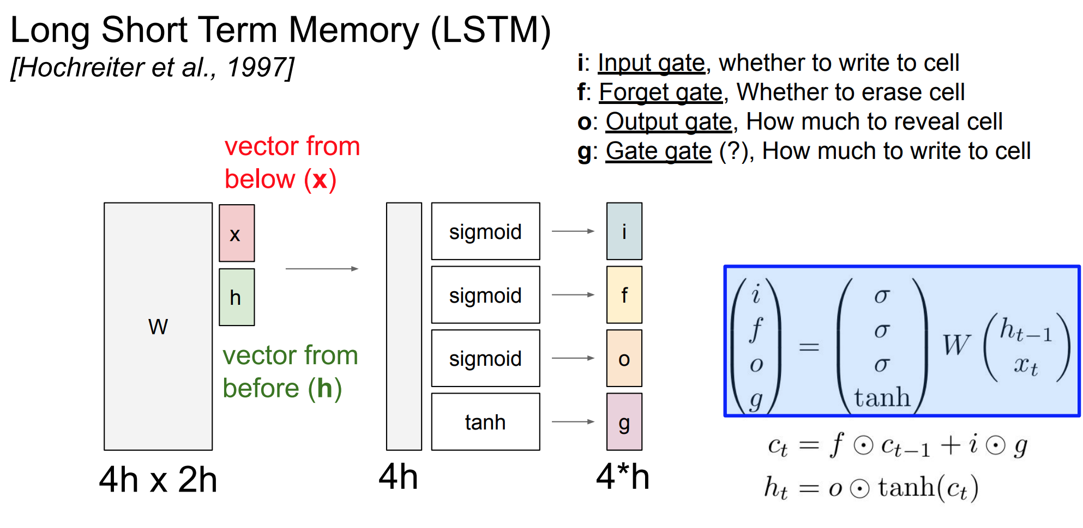

Slide 35
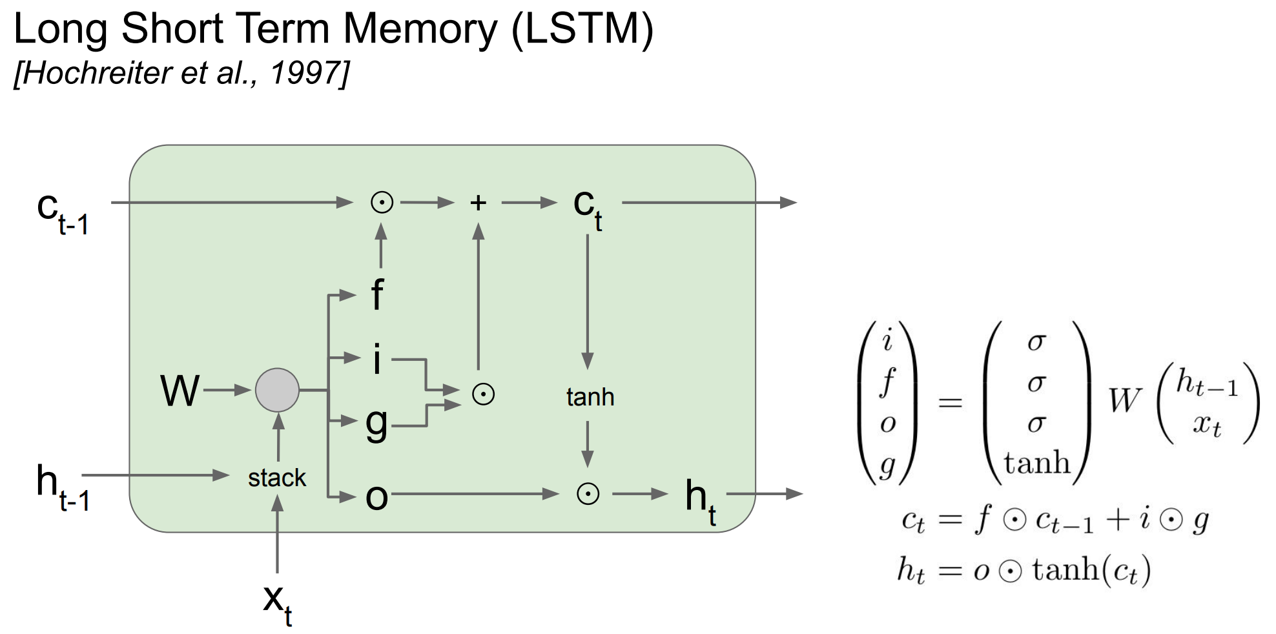

Slide 36
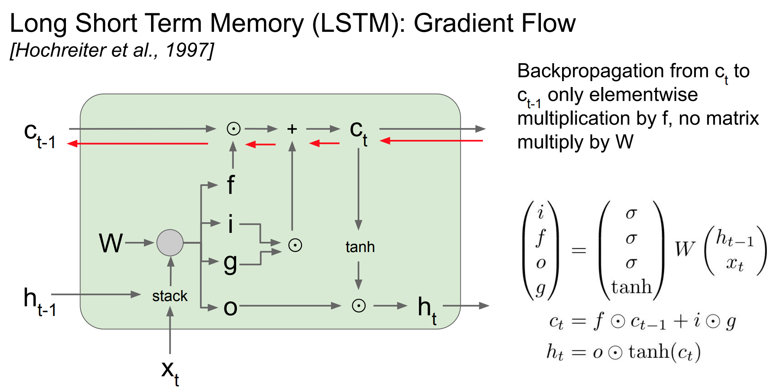

Slide 37
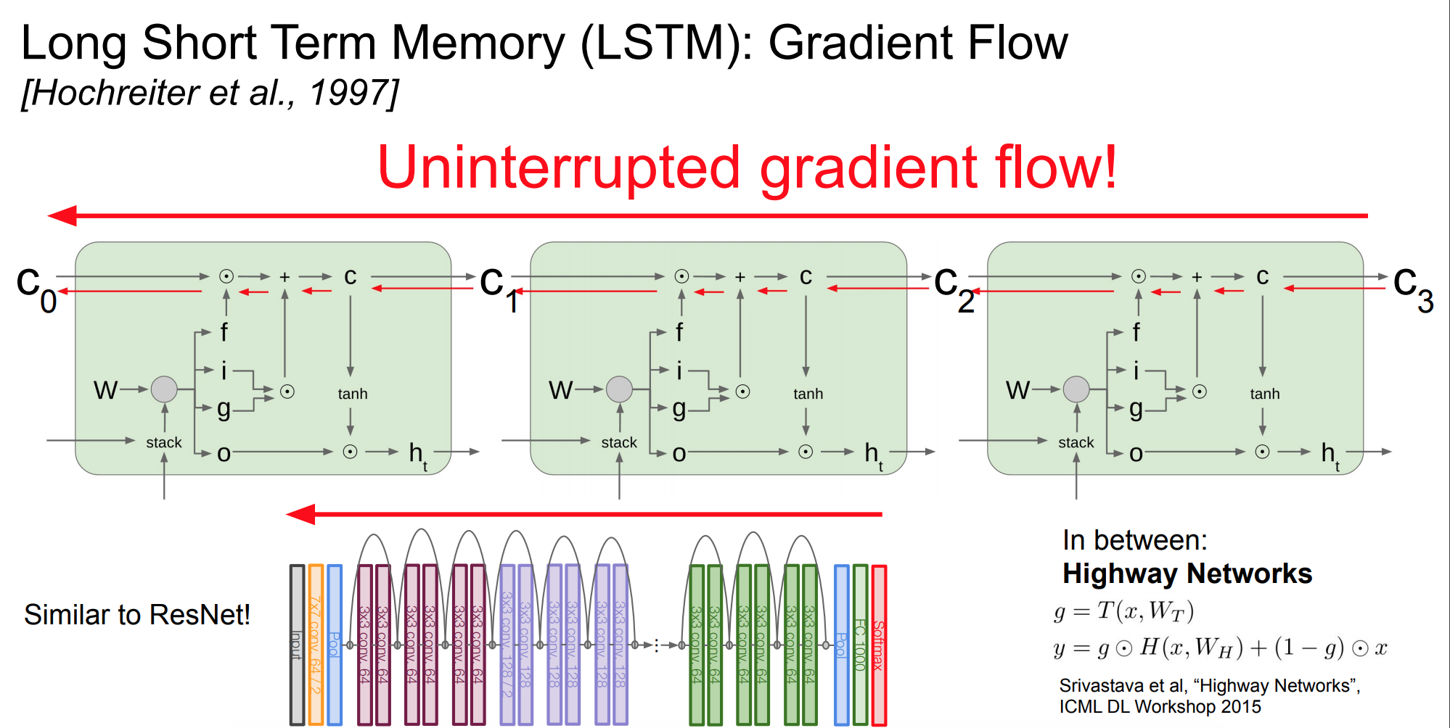

Slide 38
Other RNN Variants Exist
~1990
1997
2015

Slide 39
Multi-Layer RNNs

Slide 40
Bidirectional RNNs

Slide 41
Summary
RNNs allow for flexibility in the length (or temporal) dimension of data
Vanilla (Elman) RNNs can solve some problems but are often limited by gradient issues
LSTM, GRU, or other variants are commonly used to control gradient flow
RNN architecture and design is still an active area of research

Slide 42
Upcoming Weeks
Project Proposals!
“Modern” Sequence Processing with Deep Nets
Word embeddings
Attention
Transformer Networks
BERT

